Slide 1
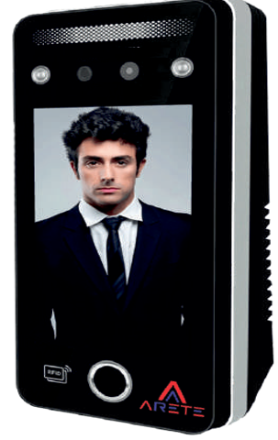
Face Detection Readers
AIFD-201/AIFD-502/AIFD-503
Model | AIFD-201/AIFD-502/AIFD-503
Power Supply | DC 9V + 5% (current: below 1.5A)
Face Capacity | 1000/5000
Fingerprint Capacity | 1500/5000
Card Capacity | 1000/5000
Transaction Logs | 10000/50000
Camera Type | 2 MP Dual -Len Camera, WDR
Interface | Wiegand (26/34)
Communication | TCP/IP
Audio Output | Voice Interface
Battery | 3 Hours Battery Backup (Optional)
Power Management | Sleep Mode
FAR/FRR | 0.01/1(%)
Identify Speed | ≤1.0 seconds
Matching Mode | Supports 1: N

