Slide 1
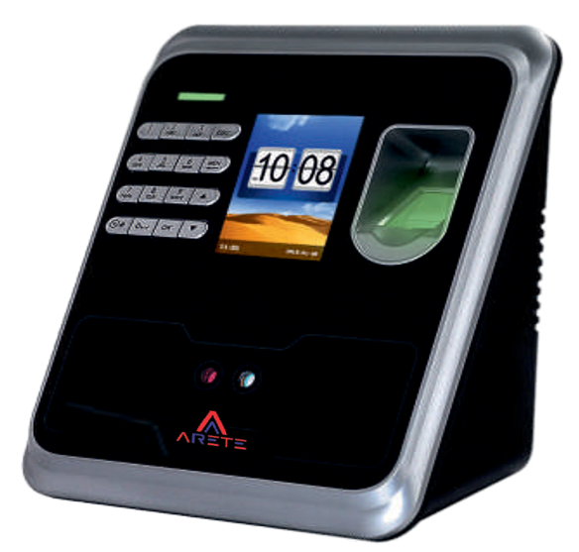
Biometric Readers
AIBM-201/AIBM-502
Model | AIBM-201/AIBM-502
Identification Mode | Fingerprint/ Card/ Password
Power Supply | 12V/2A
Master Data (Finger) | 1000/5000
Master Data (Card) | 1000/5000
Transaction Capacity | 50000/150000
Reader | Mifare/Prox (Optional)
Interface | TCP/IP, Wi-Fi
Screen Size | 2.8 inch, TFT Colour Screen
Battery | Yes
Verification Time | <0.5 Sec
Access Control | Lock, Push Button

